Slide 1
Panda: MapReduce Framework on GPU’s and CPU’s
Hui Li
Geoffrey Fox

Slide 2

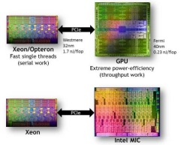
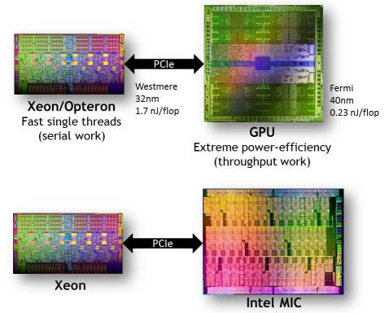
Research Goal
provide a uniform MapReduce programming model that works on HPC Clusters or Virtual Clusters cores on traditional Intel architecture chip, cores on GPU.
CUDA, OpenCL, OpenMP, OpenACC
Notes:
Traditional CPUs, whose cores are optimized for single-threaded performance, are not designed for work requiring lots of throughput FPGA
For that type of computing, much better energy efficiency can be delivered using simpler, slower, but more numerous cores. Both GPUs and the MIC adhere to this paradigm;

Slide 3
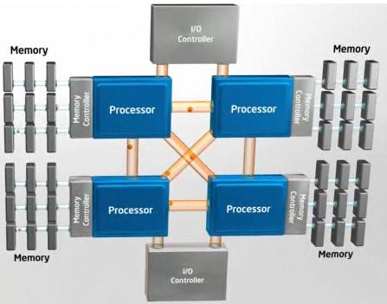
Multi Core Architecture
Sophisticated mechanism in optimizing instruction and caching
Current trends:
Adding many cores
More SIMD: SSE3/AVX
Application specific extensions: VT-x, AES-NI
Point-to-Point interconnects, higher memory bandwidths
Notes:
- Single core performance gains stagnating
- Focusing more on power optimizations, mobility

Slide 4
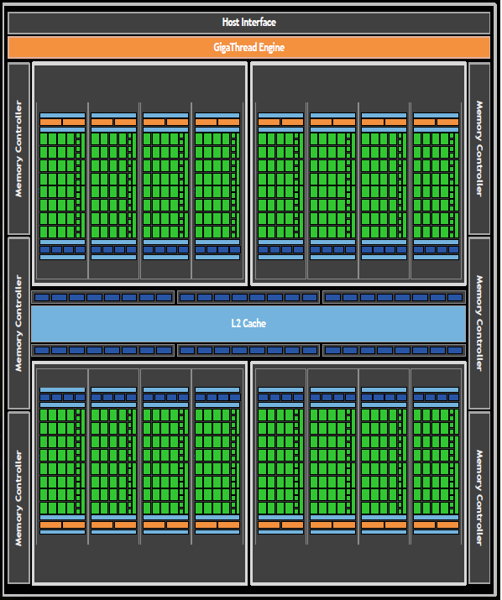
Fermi GPU Architecture
Generic many core GPU
Not optimized for single-threaded performance, are designed for work requiring lots of throughput
Low latency hardware managed thread switching
Large number of ALU per “core” with small user managed cache per core
Memory bus optimized for bandwidth

Slide 5
GPU Architecture Trends
Multi-threaded
Multi-core
Many-core
CPU
Intel Larabee NVIDIA CUDA
Fully Programmable
Programmability
GPU
Partially Programmable
Fixed Function
Throughput Performance
Figure based on Intel Larabee Presentation at SuperComputing 2009

Slide 6
Top 10 innovations in NVIDIA Fermi GPU and top 3 next challenges
 | Top 10 innovations | Top 3 next challenges
1 | Real floating point in Quality and performance | The Relatively Small Size of GPU memory
2 | Error correcting codes on Main memory and Caches | Inability to do I/O directly to GPU memory
3 | Fast Context Switching | No Glueless multi-socket hardware and software
4 | Unified Address Space | (Programmability ?)
5 | Debugging Support
6 | Faster Atomic Instructions to Support Task-Based Parallel
7 | Caches
8 | 64-bit Virtual Address Space
9 | A Brand new Instruction Set
10 | Fermi is faster than G80

Slide 7
GPU Clusters
GPU clusters hardware systems
FutureGrid 16-node Tesla 2075 “Delta” 2012
Keeneland 360-node Fermi GPUs 2010
NCSA 192-node Tesla S1070 “Lincoln” 2009
GPU clusters software systems
Software stack similar to CPU cluster
GPU resources management
GPU clusters runtimes
MPI/OpenMP/CUDA
Charm++/CUDA
MapReduce/CUDA
Hadoop/CUDA

Slide 8
GPU Programming Models
Shared memory parallelism (single GPU node)
OpenACC
OpenMP/CUDA
MapReduce/CUDA
Distributed memory parallelism (multiple GPU nodes)
MPI/OpenMP/CUDA
Charm++/CUDA
MapReduce/CUDA
Distributed memory parallelism on GPU and CPU nodes
MapCG/CUDA/C++
Hadoop/CUDA
Streaming
Pipelines
JNI (Java Native Interface)

Slide 9
GPU Parallel Runtimes
Name | Multiple GPUs | Fault Tolerance | Communication | GPU Programming Interface
Mars | No | No | Shared | CUDA/C++
OpenACC | No | No | Shared | C,C++,Fortran
GPMR | Yes | No | MVAPICH2 | CUDA
DisMaRC | Yes | No | MPI | CUDA
MITHRA | Yes | Yes | Hadoop | CUDA
MapCG | Yes | No | MPI | C++

Slide 10
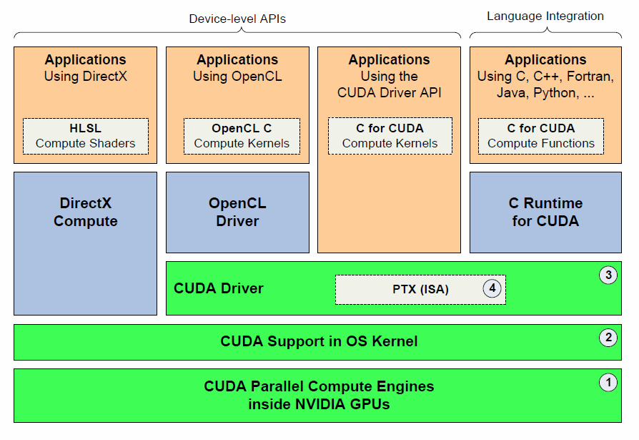
CUDA: Software Stack
Image from [5]

Slide 11
CUDA: Program Flow
Application Start
Search for CUDA Devices
Load data on host
Allocate device memory
Copy data to device
Launch device kernels to process data
Copy results from device to host memory
Main Memory
CPU
Host
PCI-Express
Device
GPU Cores
Device Memory

Slide 12
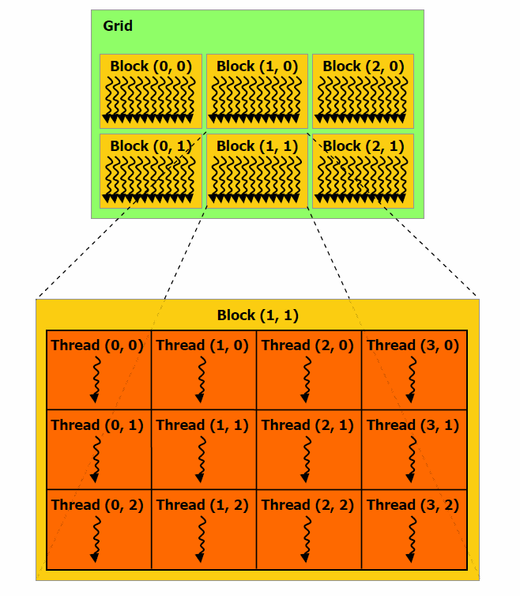
CUDA: Thread Model
Kernel
A device function invoked by the host computer
Launches a grid with multiple blocks, and multiple threads per block
Blocks
Independent tasks comprised of multiple threads
no synchronization between blocks
SIMT: Single-Instruction Multiple-Thread
Multiple threads executing time instruction on different data (SIMD), can diverge if neccesary
Image from [3]

Slide 13
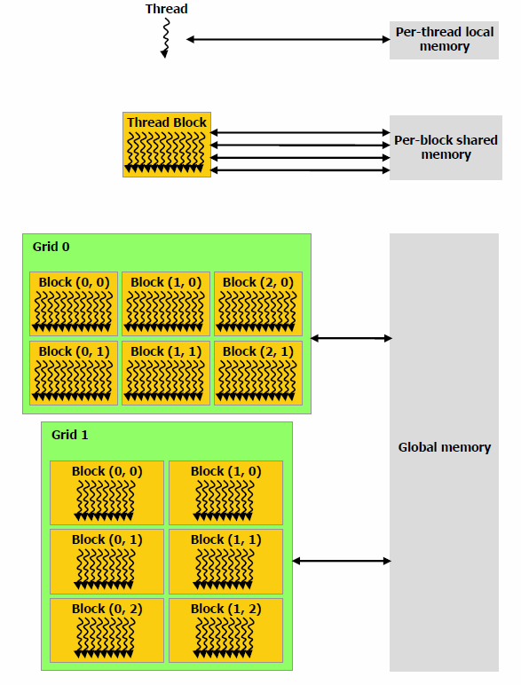
CUDA: Memory Model
Image from [3]
Notes:
Avoid task switching overhead by statically allocating thread resources

Slide 14
Panda: MapReduce Framework on GPU’s and CPU’s
Current Version 0.2
Applications:
Word count
C-means clustering
Features:
Run on two GPUs cards
Some initial iterative MapReduce support
Next Version 0.3
Features:
Run on GPU’s and CPU’s (done for word count)
Optimized static scheduling (todo)

Slide 15
Panda: Data Flow
Panda Scheduler
CPU Cores
CPU Memory
PCI-Express
Shared memory
GPU accelerator group
CPU processor group
GPU Cores
GPU Memory
CPU Cores
CPU
Memory

Slide 16
Architecture of Panda Version 0.3
Configure Panda job, GPU and CPU groups
Iterations
Static scheduling based on GPU and CPU capability
GPU Accelerator Group 1
GPUMapper<<<block,thread>>>
Round-robin Partitioner
GPU Accelerator Group 2
GPUMapper<<<block,thread>>>
Round-robin Partitioner
CPU Processor Group 1
CPUMapper(num_cpus)
Hash Partitioner
3
16
5
6
10
12
13
7
2
11
4
15
9
16
8
1
Copy intermediate results of mappers from GPU to CPU memory; sort all intermediate key-value pairs in CPU memory
1
2
3
4
5
6
7
8
9
10
11
12
13
14
15
16
Static scheduling for reduce tasks
GPU Accelerator Group 1
GPUReducer<<<block,thread>>>
Round-robin Partitioner
GPU Accelerator Group 2
GPUReducer<<<block,thread>>>
Round-robin Partitioner
CPU Processor Group 1
CPUReducer(num_cpus)
Hash Partitioner
Merge Output

Slide 17
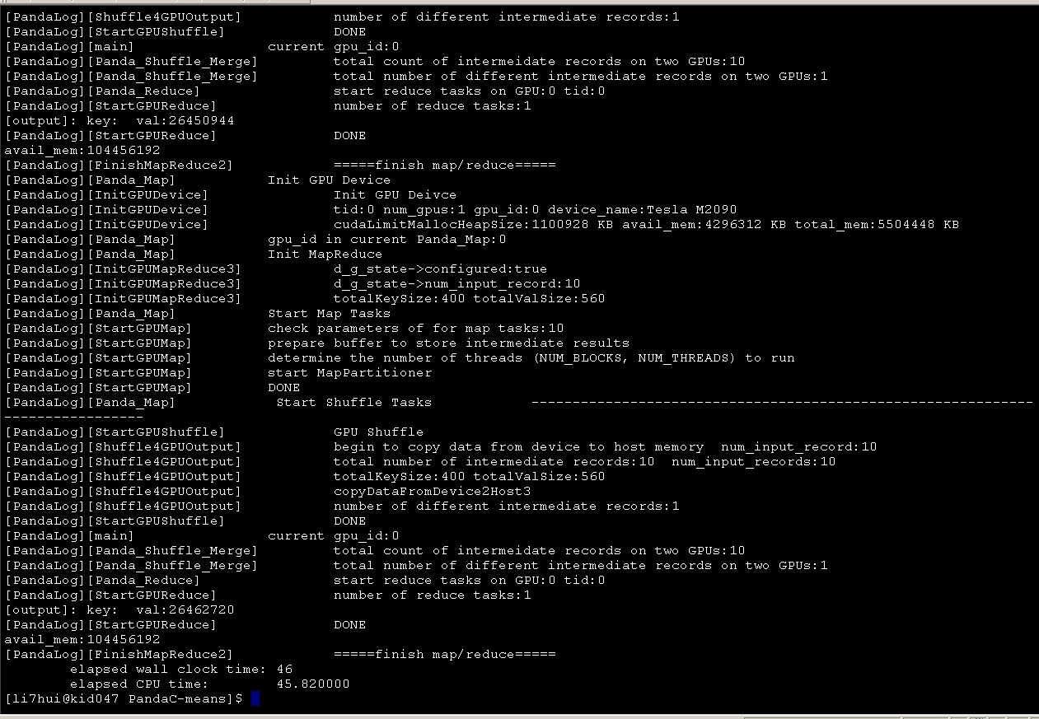

Slide 18
Panda’s Performance on GPU’s
2 GPU: T2075
C-means Clustering (100dim,10c,10iter, 100m)

Slide 19
Panda’s Performance on GPU’s
1 GPU T2075
C-means clustering (100dim,10c,10iter,100m)

Slide 20
Panda’s Performance on CPU’s
20 CPU Xeon 2.8GHz; 2GPU T2075
Word Count Input File: 50MB

Slide 21
Acknowledgement
FutureGrid
SalsaHPC

